Slide 1





“SOLAR PV POWER PLANT IN CHINA”
GROUP 7
TRANG PHAM (X6457492)
TASKEEN HAIDER(2403722)
YUBRAJ THAPA MAGAR (X7252148)
CHIPPY CHANDRA PILLAI (X1545624)
MOHAMMAD EKRAMUL HAQUE (X0813185)

Slide 2

INTRODUCTION
COMPANY OVERVIEW: TECTY SOLAR, ESTABLISHED IN 2006 IN HUAINAN, CHINA.
CORE BUSINESS: SPECIALIZES IN SOLAR PV PANEL DESIGN, PRODUCTION, AND DISTRIBUTION.
MISSION: PROMOTE SUSTAINABILITY, ENERGY ACCESSIBILITY, AND INNOVATION.
KEY TECHNOLOGIES: MONOCRYSTALLINE, POLYCRYSTALLINE, BIFACIAL MODULES, AND PERC TECHNOLOGY.

Slide 3
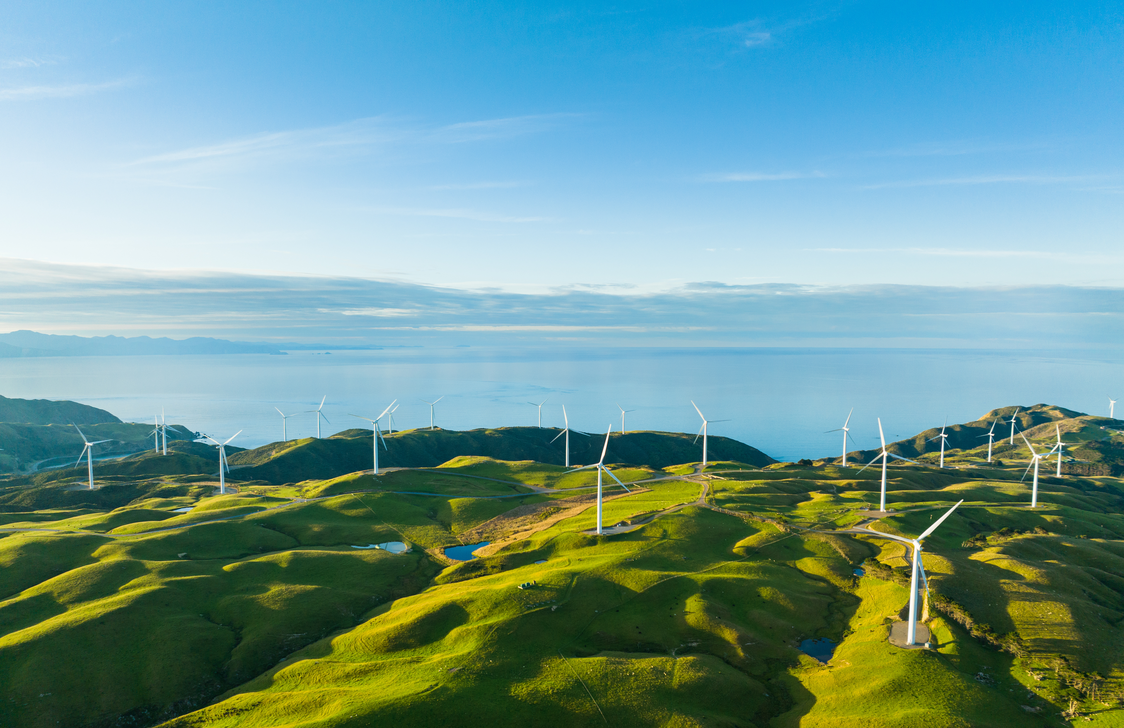

LOCATION: HUAINAN, ANHUI PROVINCE, CHINA.
POPULATION: ~2.3 MILLION.
ENERGY CONSUMPTION: RISING DEMAND FOR ELECTRICITY; CHINA’S POWER USE INCREASED BY 7% ANNUALLY.
SOLAR POTENTIAL: 2000-2200 HOURS OF SUNLIGHT ANNUALLY.
GOVERNMENT INCENTIVES: SUBSIDIES, TAX BENEFITS, AND FEED-IN TARIFFS.
MARKET SNAPSHOT

Slide 4

MARKET ANALYSIS
ECONOMIC & TECHNOLOGICAL FACTORS:
PV PANEL COSTS HAVE DROPPED DUE TO TECHNOLOGICAL ADVANCEMENTS.
ENERGY STORAGE SOLUTIONS (LITHIUM-ION BATTERIES) ENHANCE RELIABILITY.
COMPETITIVE LANDSCAPE:
Key players: TRINA SOLAR, LONGI SOLAR, AND SUNGROW.
TECTY SOLAR’S ADVANTAGE: HIGH-EFFICIENCY PANELS, SMART GRID SOLUTIONS, STRONG LOCAL PARTNERSHIPS.
REGULATORY & ENVIRONMENTAL FACTORS:
SUPPORTIVE POLICIES UNDER CHINA’S RENEWABLE ENERGY LAW.
REDUCING RELIANCE ON COAL, IMPROVING AIR QUALITY.

Slide 5
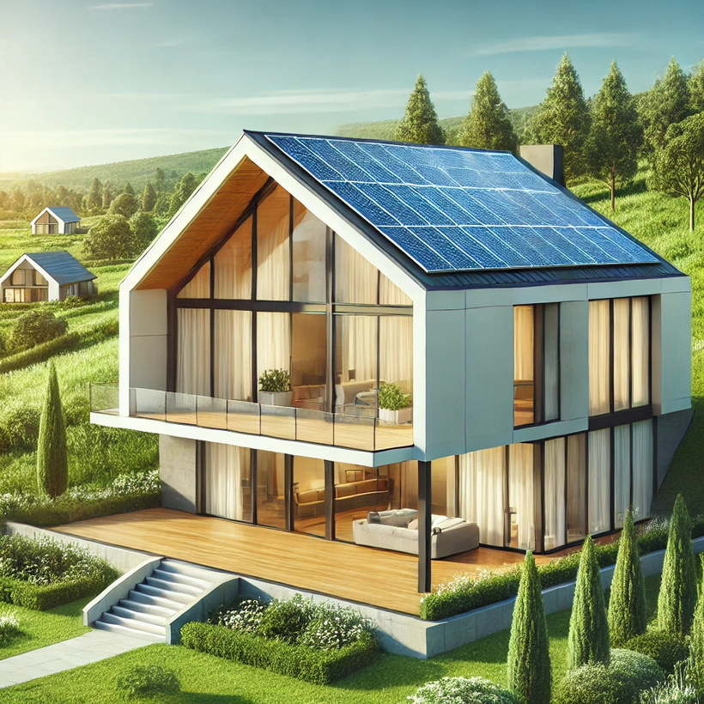
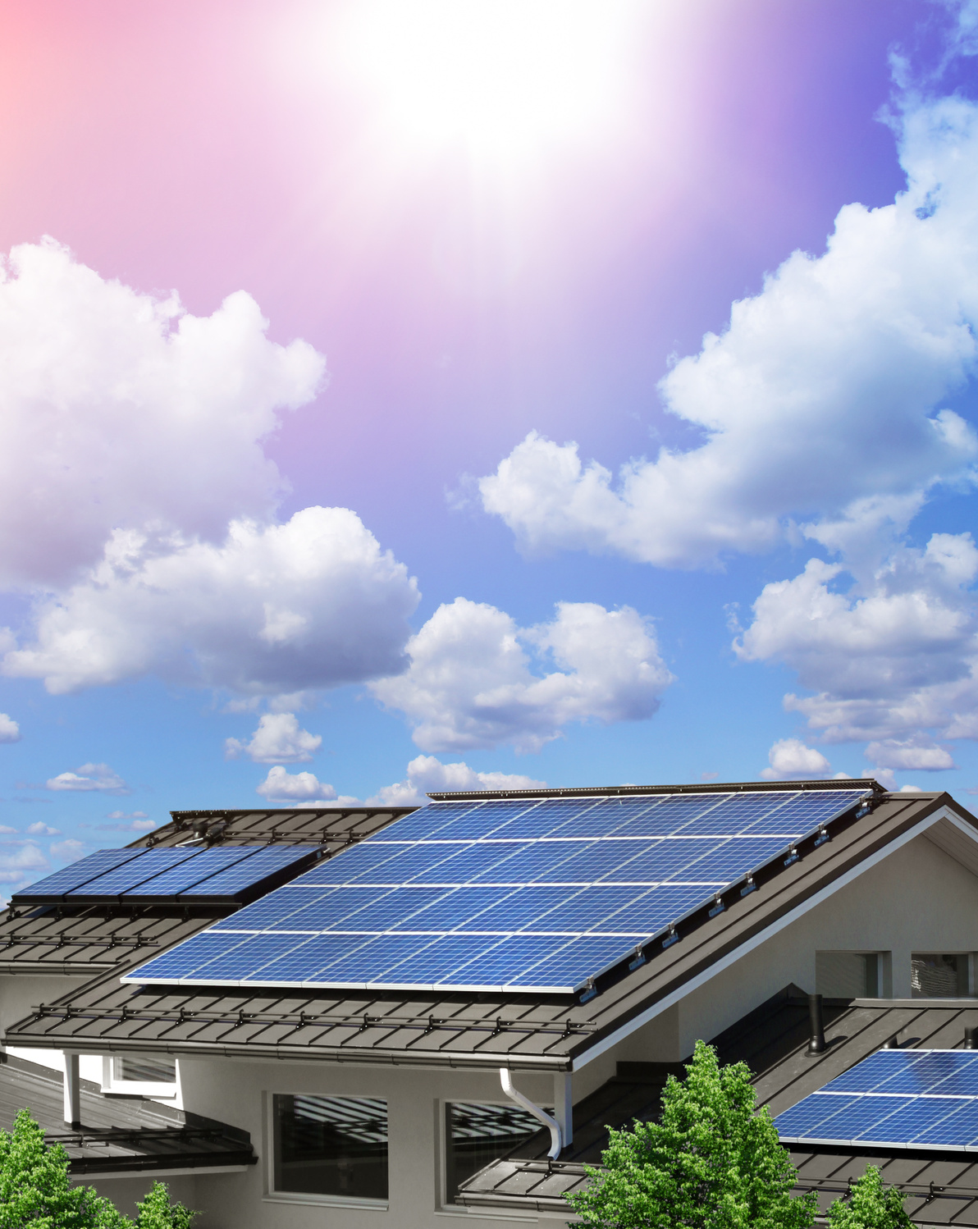
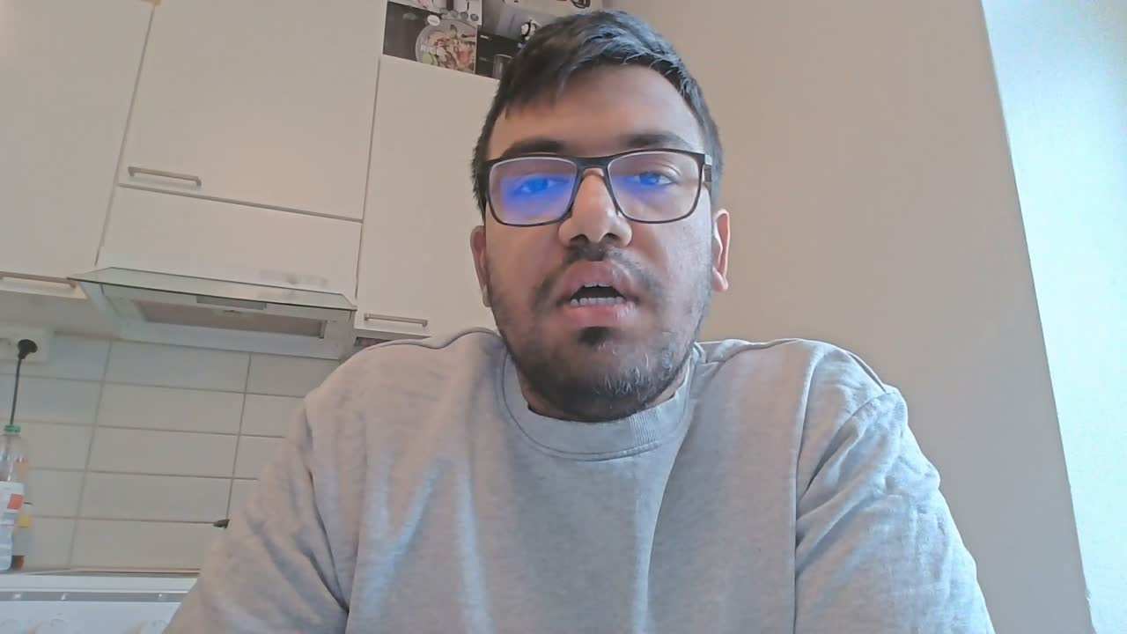
MARKET NEED
ENERGY SECURITY: DECENTRALIZED SOLAR SOLUTIONS REDUCE POWER OUTAGES.
Cost Savings: Lower electricity bills + income from selling excess power.
Environmental Benefits: Reduces coal dependency, and improves public health.
Technological Innovation: Smart grids, energy storage, and increased accessibility.

Slide 6

INNOVATIVE TECHNOLOGIES
Our solutions are powered by the latest advancements in renewable energy technology, ensuring that your business benefits from cutting-edge systems that maximize efficiency and return on investment.
SMART GRID INTEGRATION
ADVANCED SOLAR PANELS
WIND TURBINE INNOVATION
NEXT-GENERATION BATTERIES

Slide 7
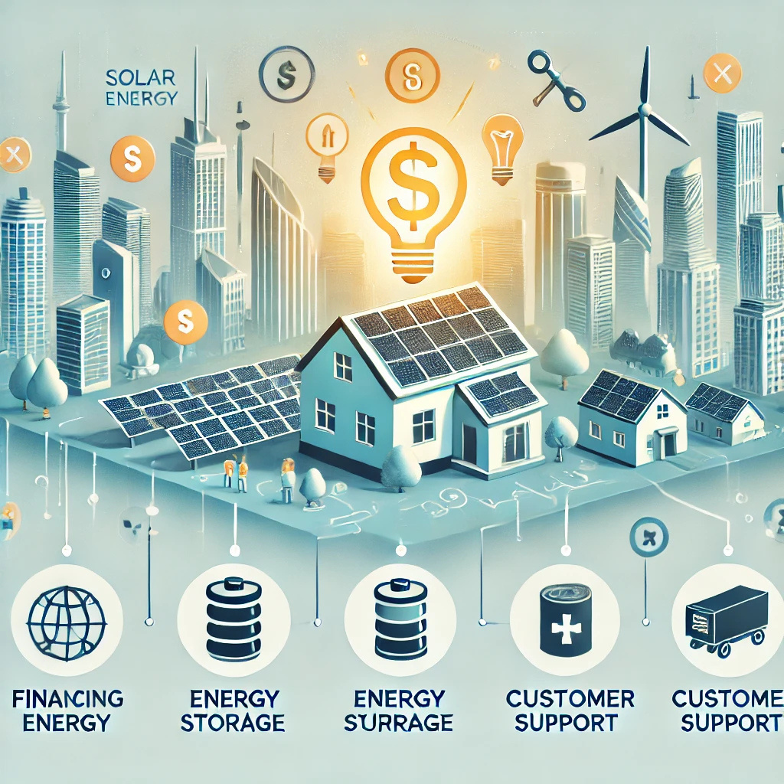

MARKET OVERVIEW & KEY COMPETITORS
MARKET CONTEXT
KEY COMPETITORS IN HOUSEHOLD PV MARKET:
Huainan City offers strong potential for household solar PV adoption.
Government incentives and infrastructure support renewable energy growth.
JA Solar – Market leader, but limited in household focus and after-sales service.
Trina Solar – Advanced tech, but higher cost and limited presence in Huainan.
LONGi Solar – Affordable and household-focused, but lacks hybrid solutions.
Sungrow – Local player with storage solutions, but new to direct consumer marketing.

Slide 8

MARKET GAPS & OPPORTUNITIES
UNMET NEEDS IN HUAINAN'S HOUSEHOLD PV MARKET
📢 Localized Marketing: Competitors focus more on utility-scale; lack tailored household outreach.
💰 Financing Options: Limited flexible plans like leasing or PAYG for middle-income families.
🔧 After-Sales Support: Weak local service infrastructure discourages adoption.
⚡ Storage Solutions: No clear leader in integrated solar + battery offerings.
OPPORTUNITY FOR TECTY SOLAR
🎯 Enter with customer-focused, affordable, and support-driven solutions.

Slide 9

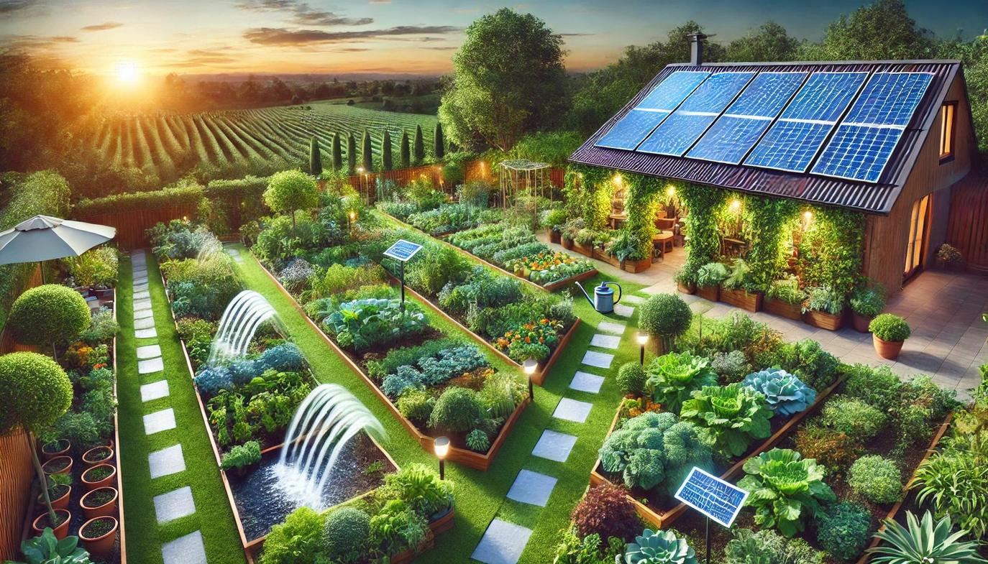
Localized Strategy: Tailored campaigns for Huainan households & partnerships with real estate developers.
Flexible Financing: Solar loans, PAYG, and subsidy guidance to improve affordability.
Customer Support: Establish in-city service hubs with fast maintenance and extended warranties.
Innovative Storage: Introduce hybrid systems for day-night power usage.
🏆 TECTY SOLAR AIMS TO BRIDGE THE SERVICE AND
AFFORDABILITY GAP IN A HIGH-POTENTIAL MARKET
TECTY SOLAR’S COMPETITIVE ADVANTAGE

Slide 10
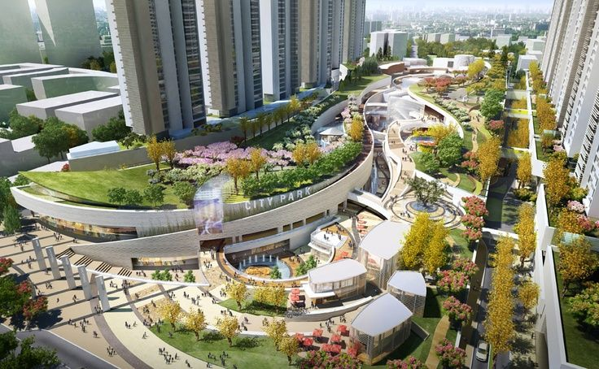
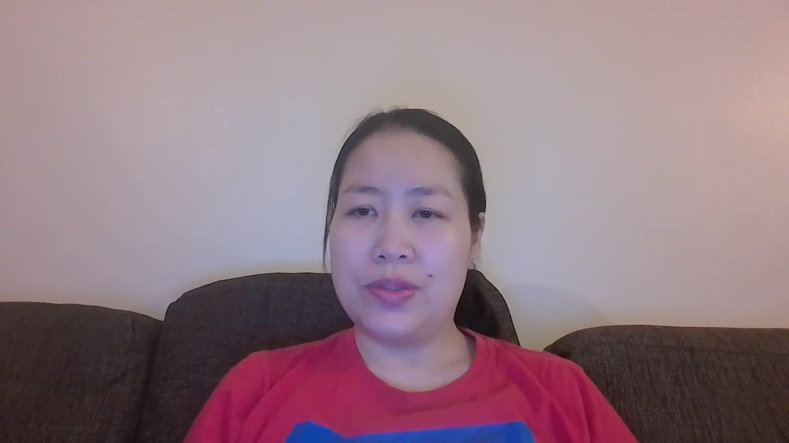
CONSUMER ANALYSIS
DEMOGRAPHIC
Population: around 3 million
Density: Averagely 550/km2, while in urban city 1000/km2
Urbanization rate: High.
GDP per capita: ~US$7,430
POWER CONSUMPTION
Summer: Approximately 4.93 kWh/day
Autumn: Approximately 3.78 kWh/day
Winter: Approximately 3.19 kWh/day

Slide 11
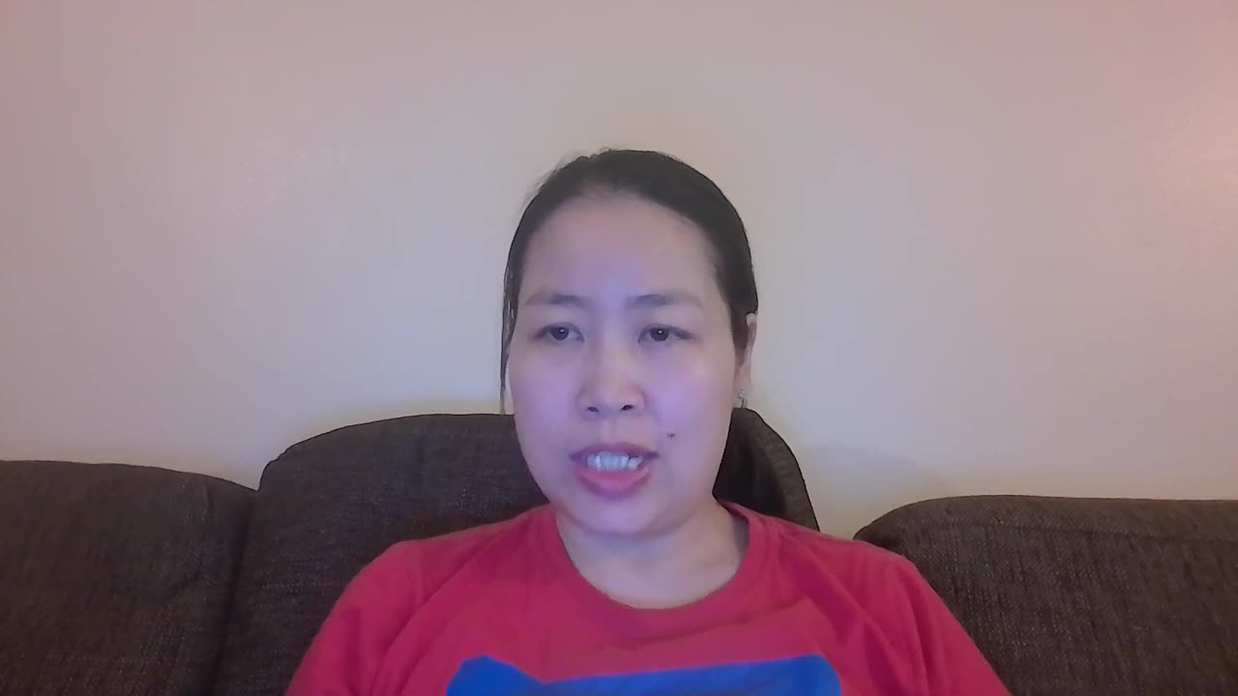
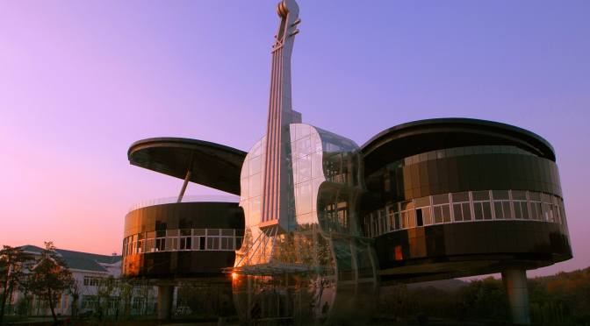
CONSUMER ANALYSIS
CUSTOMER SEGMENTATION
Eco-Conscious Consumers: Individuals motivated by environmental benefits, likely to adopt PV systems despite higher costs.
Economically Driven Consumers: Residents primarily interested in cost savings, who may be sensitive to initial investment and return on investment timelines.
Traditional Consumers: Individuals resistant to change, preferring conventional energy sources due to familiarity and perceived reliability
Generally, all of our target customers are living in the urban areas.

Slide 12














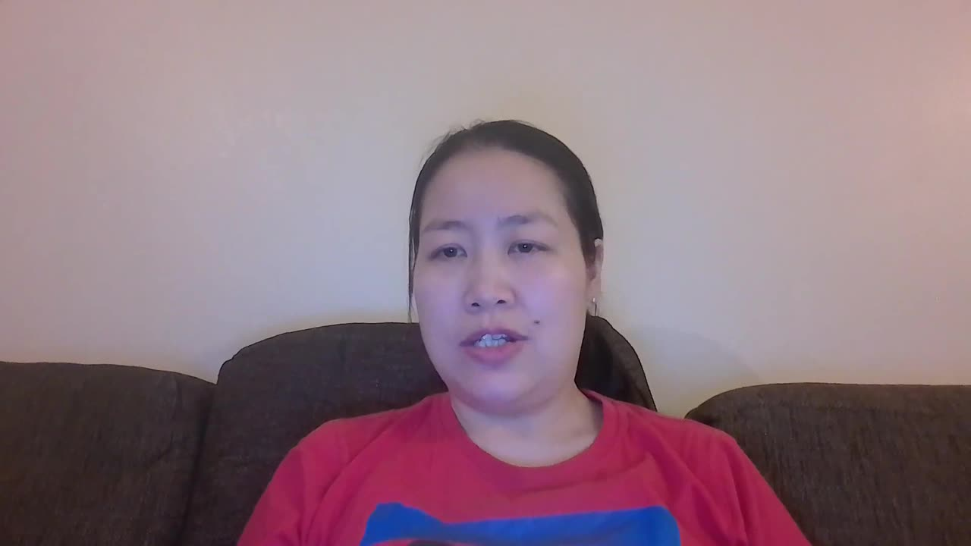



PV HOUSEHOLD INSTALLATION PROCESS
Research & selection
Consultation
Financial Planning
Consult with certified installers for set-up
Financial planning to ensure the investment is manageable and cost-effective
Selecting the right PV system in need
Permitting Appproval
Installation
Inspection
Professional installation ensures that the system is safely and efficiently connected.
Final inspection is conducted to verify that the system meets all safety and performance standards
Ensure their PV system complies with local regulations

Slide 13


SWOT ANALYSIS
S
W
STRENGTHS
WEAKNESSES
Strong potential location with growing demand
Technological expertise in next-gen technology
Large-scale production capacity
Government support through incentives
High capital investment costs
High initial costs for middle-income customers
Aesthetic concerns for some households
Lack of awareness about solar benefits
O
T
OPPORTUNITIES
THREATS
Collaboration with local companies
Partnership with real estate developers
Educational awareness programs
Integration with nuclear power
Industry competition from established companies
Market fluctuations and inflation
Risk of technological obsolescence
Public concerns about nuclear integration

Slide 14
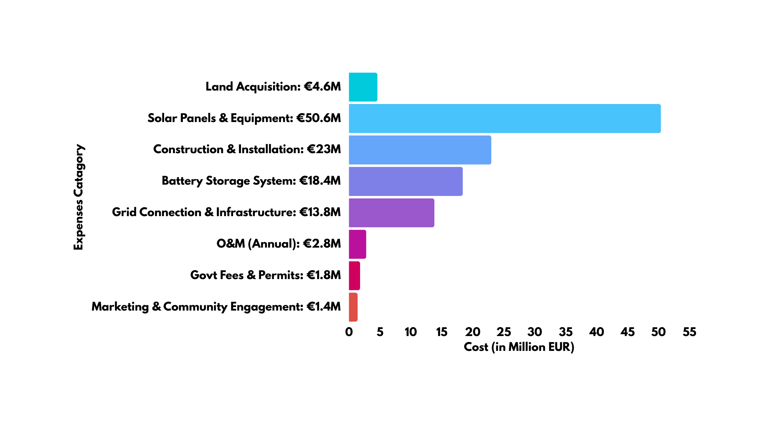

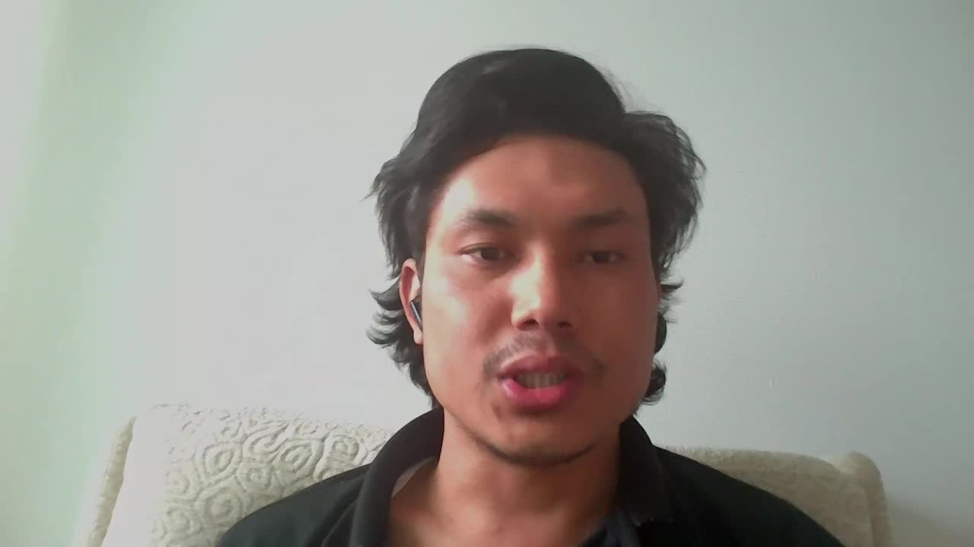
COST AND REVENUE ESTIMATION
Cost Breakdown (100MW Solar PV Plant)

Slide 15

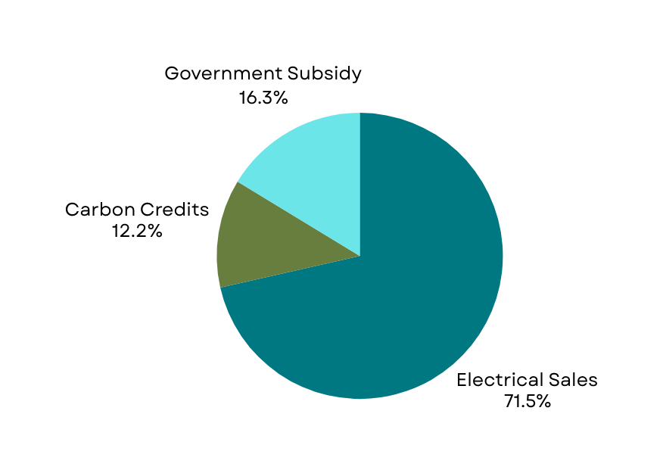
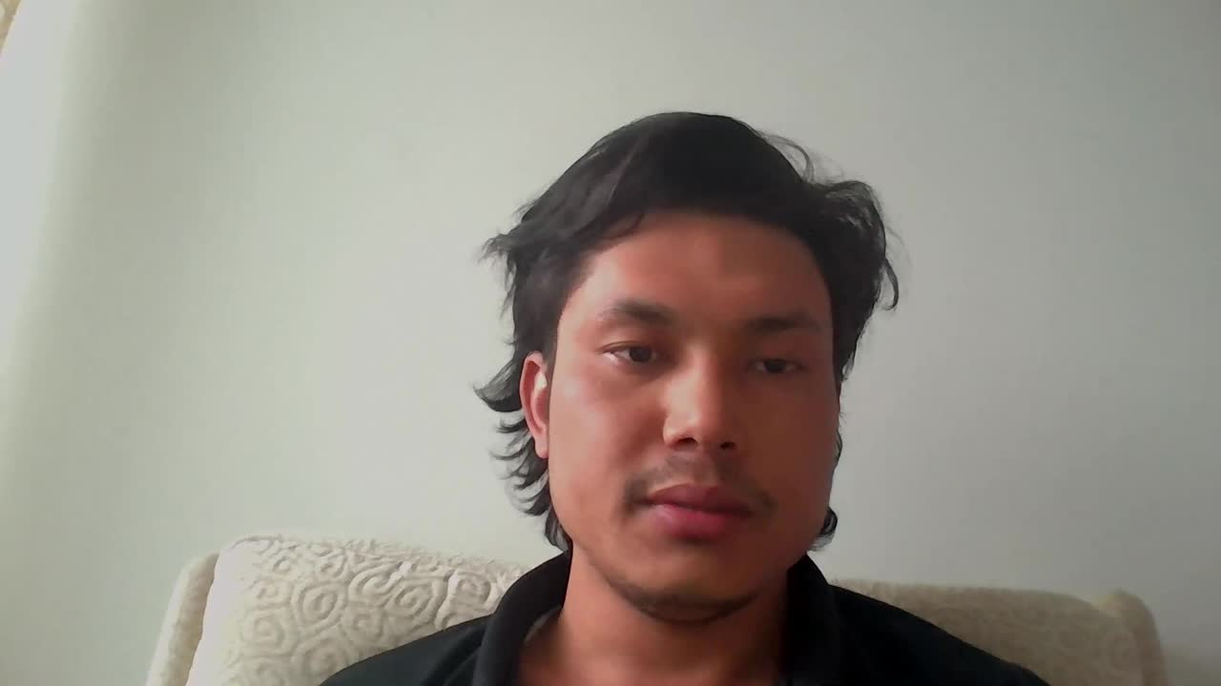
Revenue & Break-Even
Annual Energy Production:
100MW plant operating at 20% capacity factor
Produces 175,200 MWh per year
Projected Revenue:
Electricity sales: €8.06 million
Carbon credits: €1.38 million
Government subsidies: €1.84 million
“Total annual revenue: €11.28 million”
Break-Even Analysis:
Break-even period: approximately 10.3 years

Slide 16

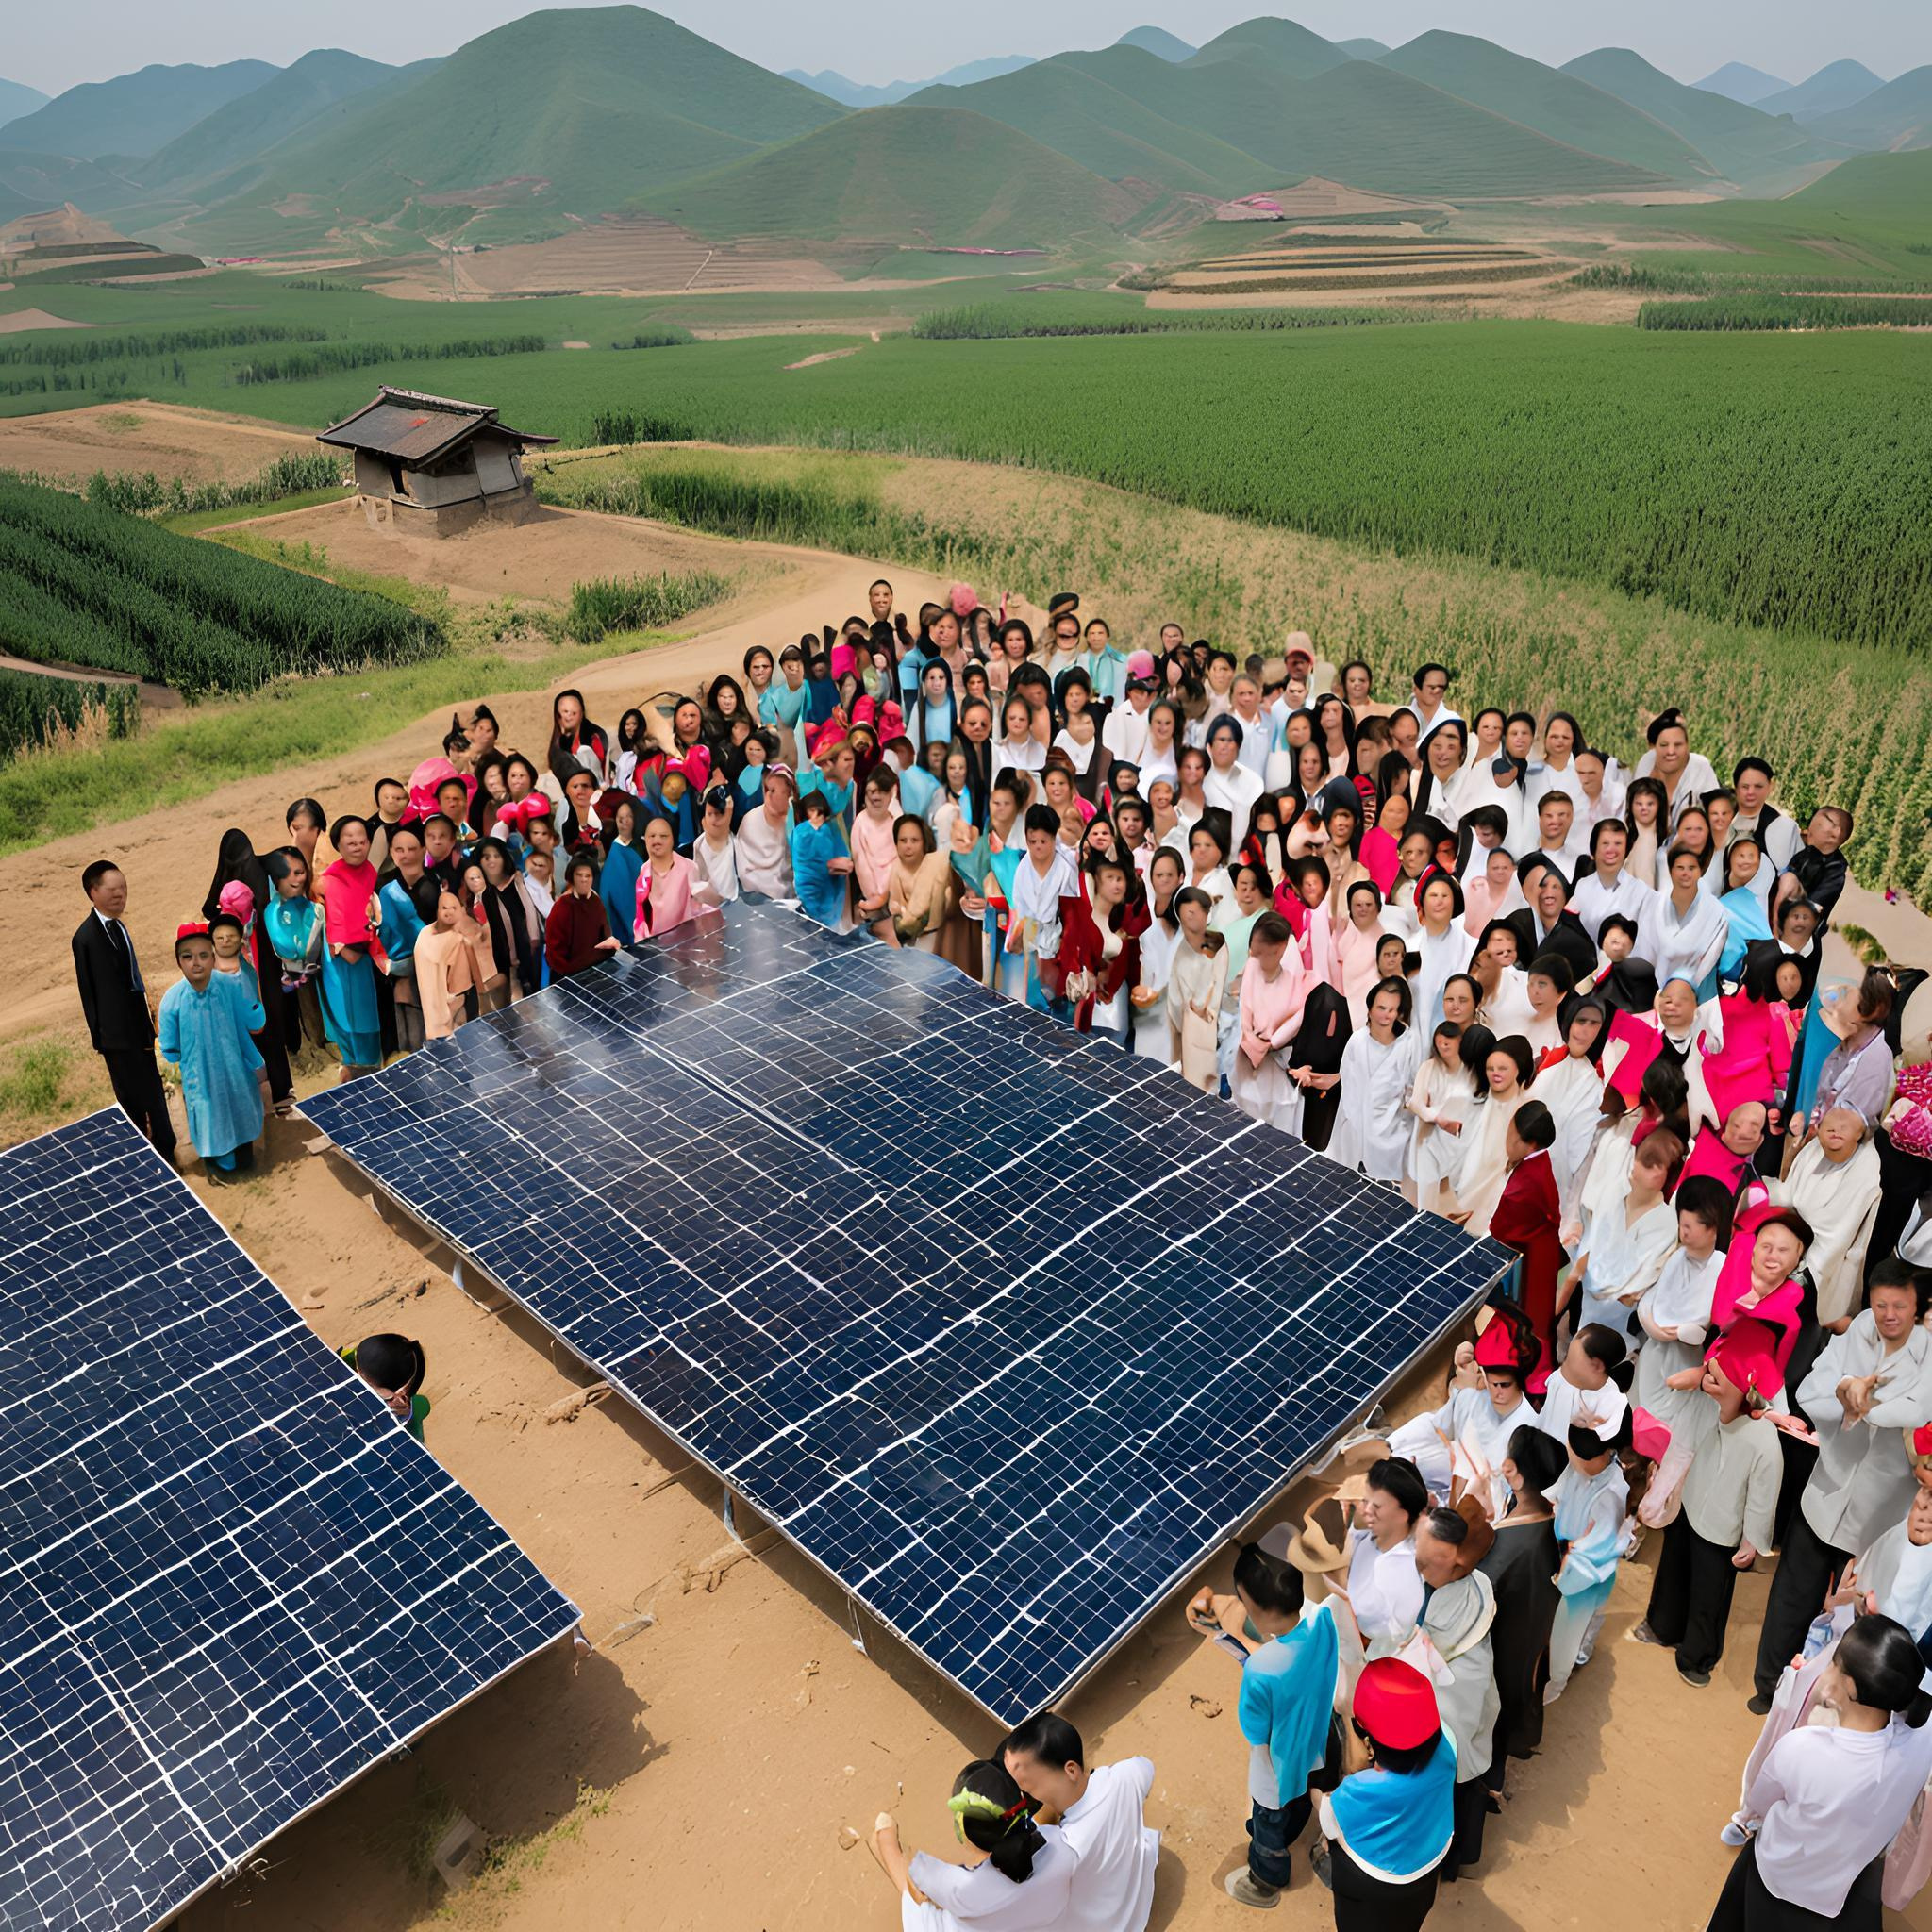
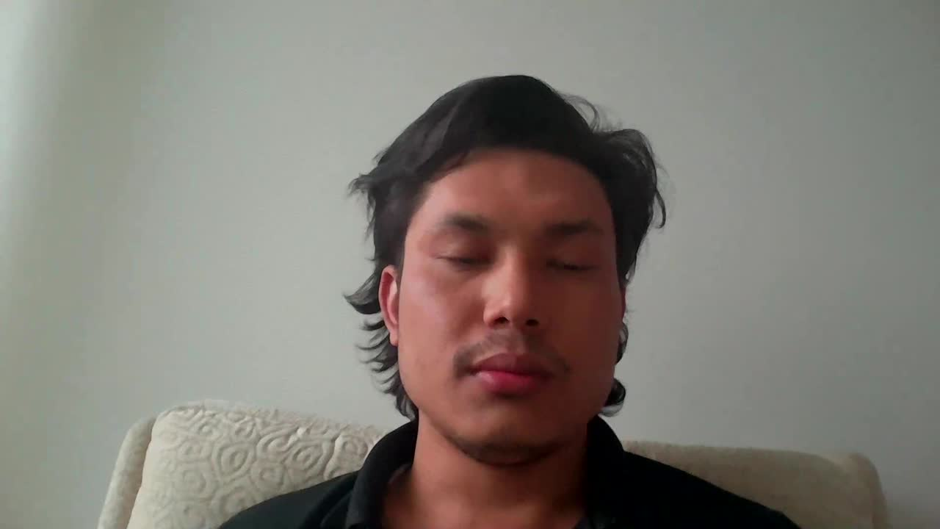
Promotional Campaign
Boost awareness and adoption of TECTY Solar's household PV systems, emphasizing sustainable energy and financial savings.

Slide 17
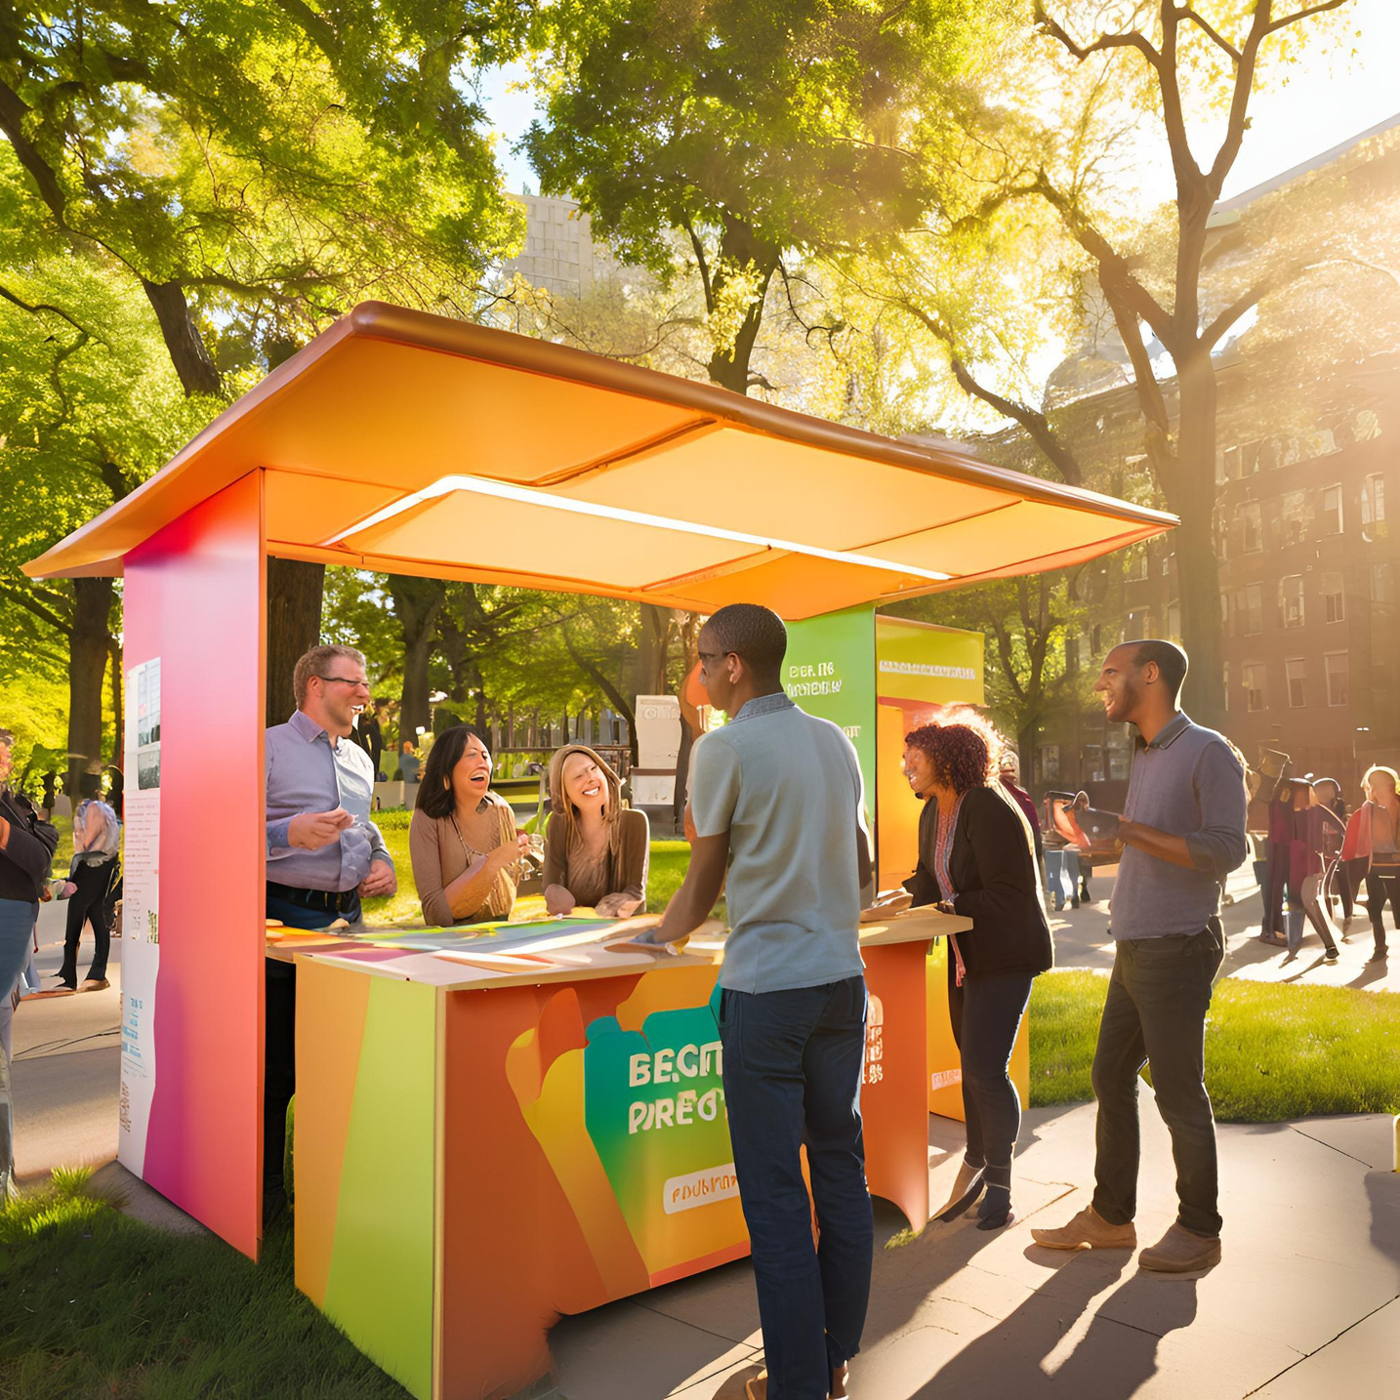



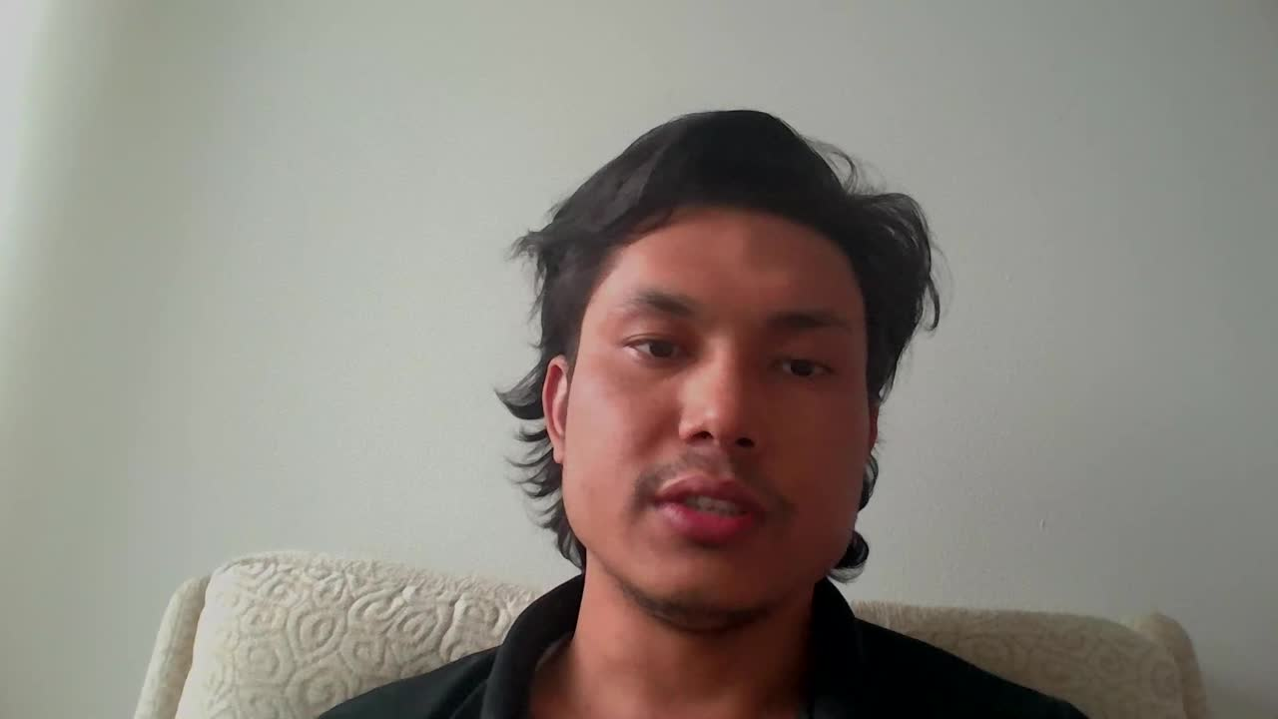
Promotional Campaign
Target Audience
Middle-income homeowners, eco-conscious families, suburban & rural residents
“Power your home with sunshine – Save more, worry less!”
(用阳光发电，让家更省心！)
Key Initiatives
Online: Social media challenges, influencer partnerships, email newsletters
Offline: Promotional booths, community roadshows, home assessment workshops
Incentives: Starter package discounts, referral programs, and government subsidy support

Slide 18
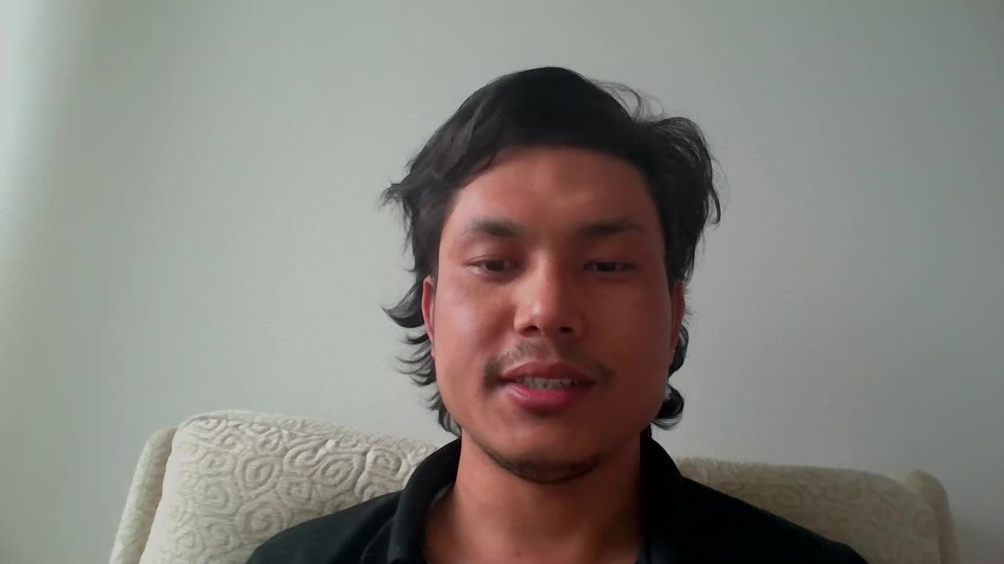
THANK YOU FOR YOUR ATTENTION
GROUP 7
“SOLAR PV POWER PLANT IN CHINA”
(SUSTAINABLE PROJECT MARKETING)

